Slide 1




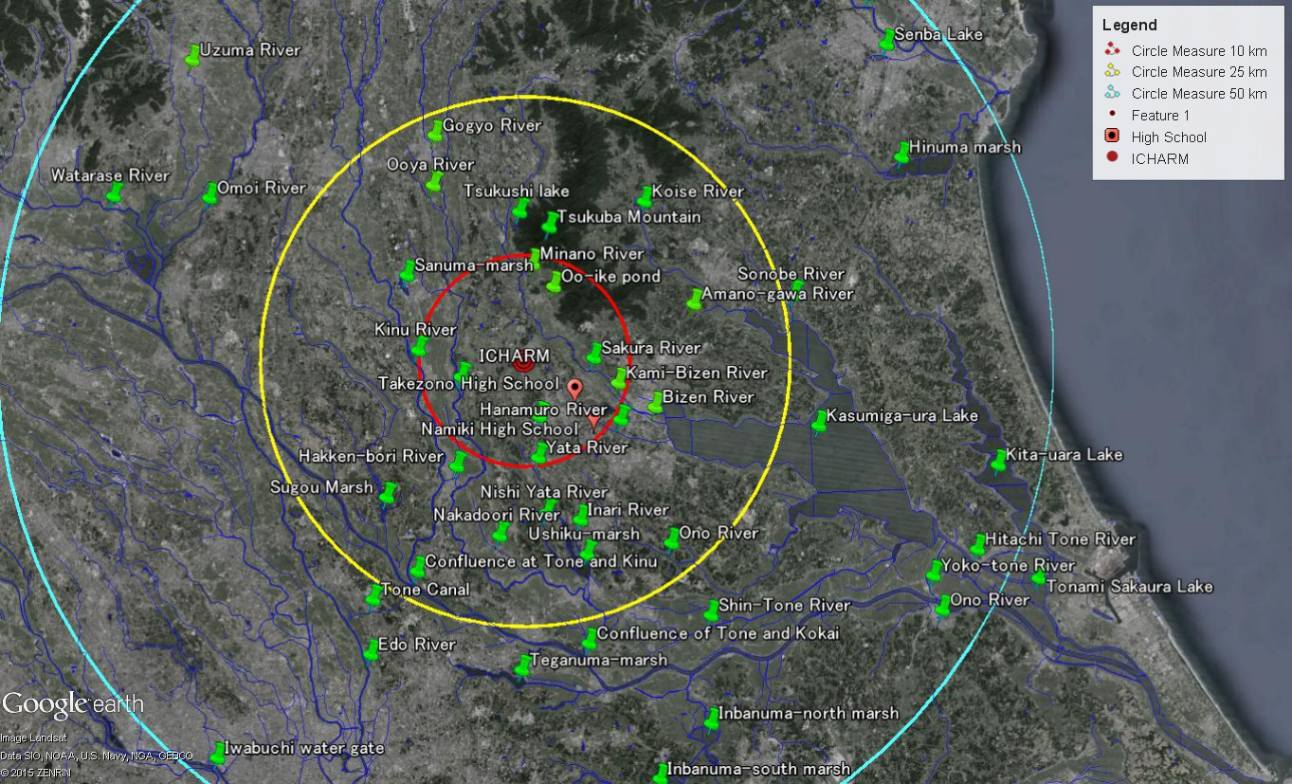
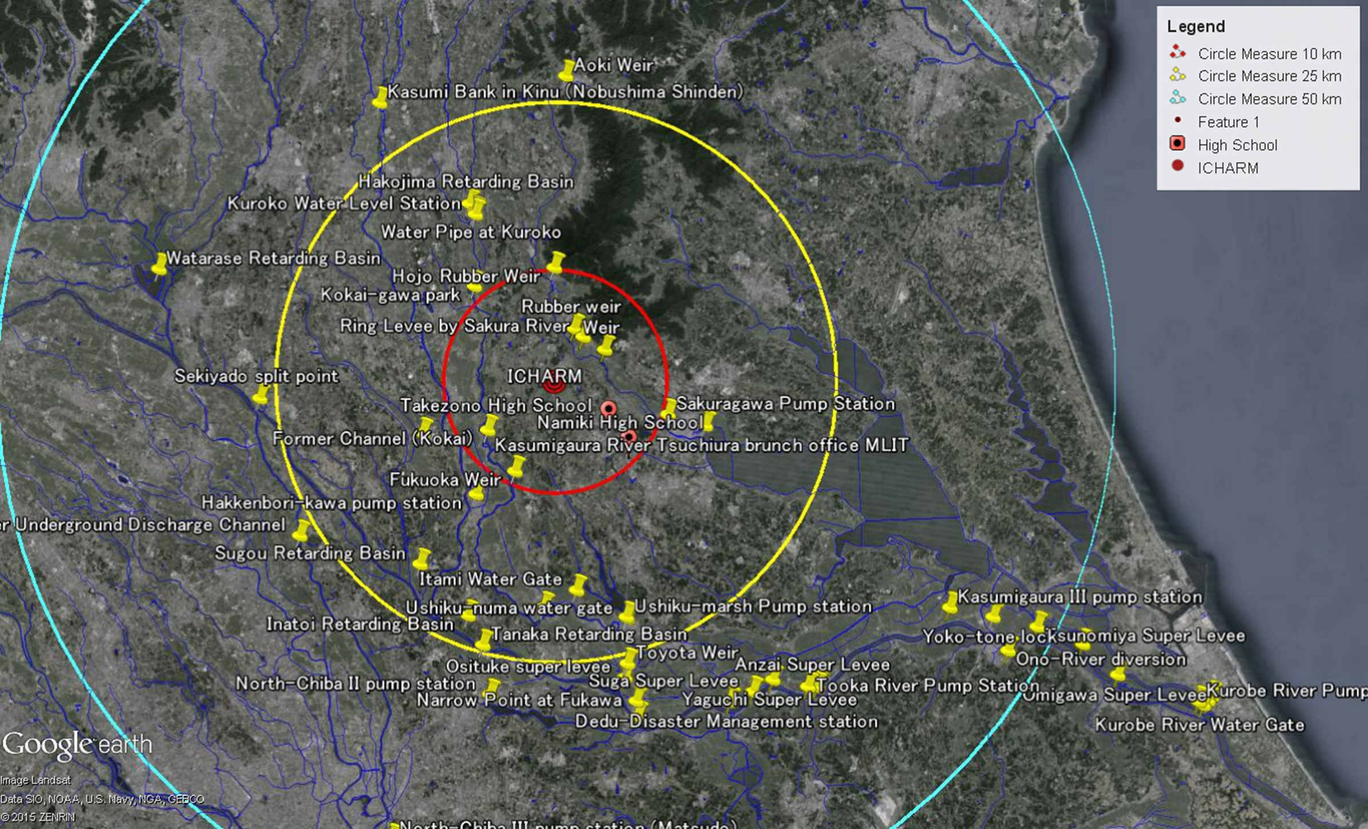
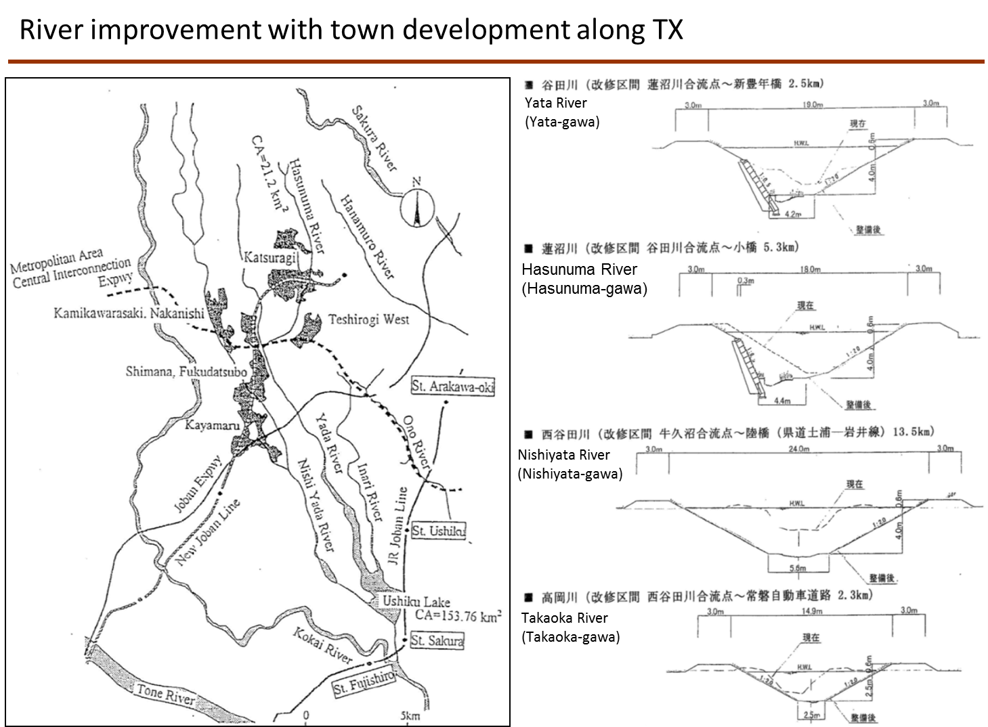
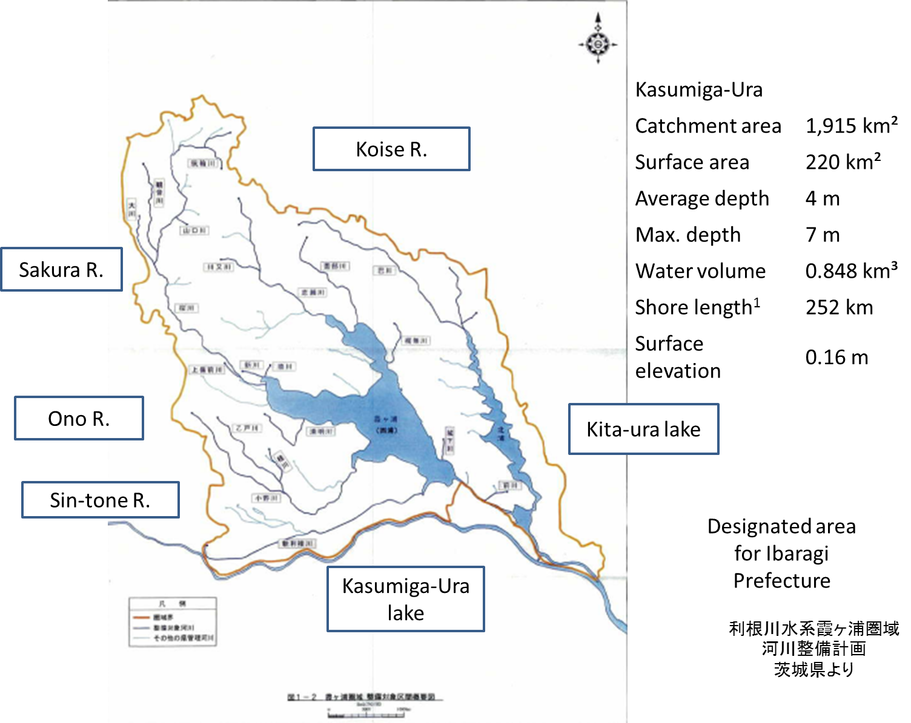
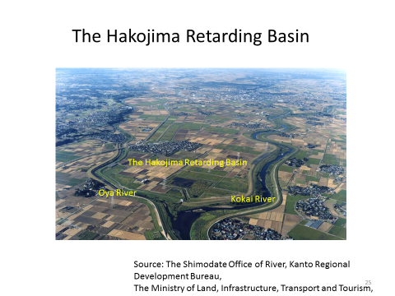
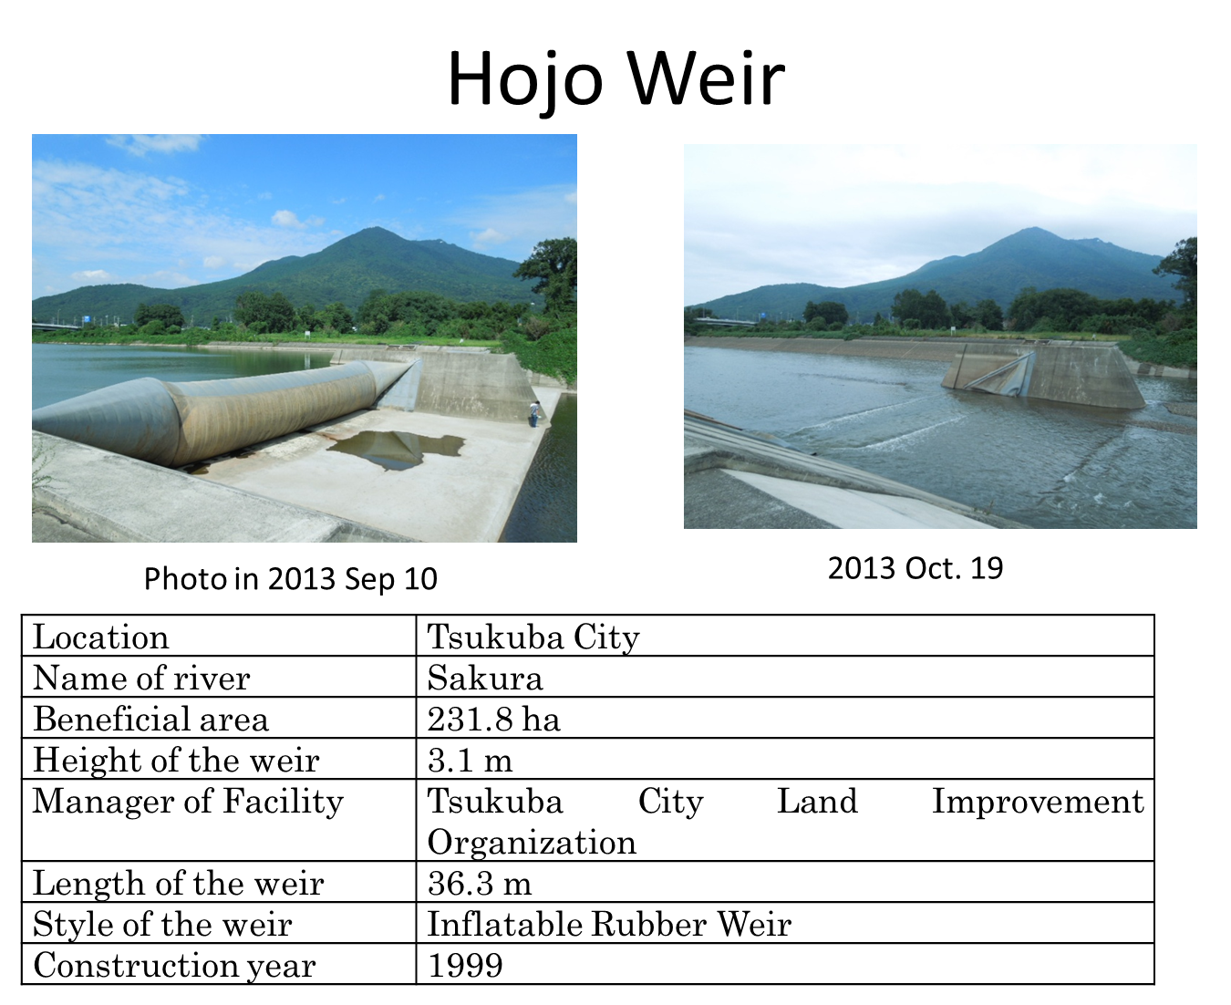
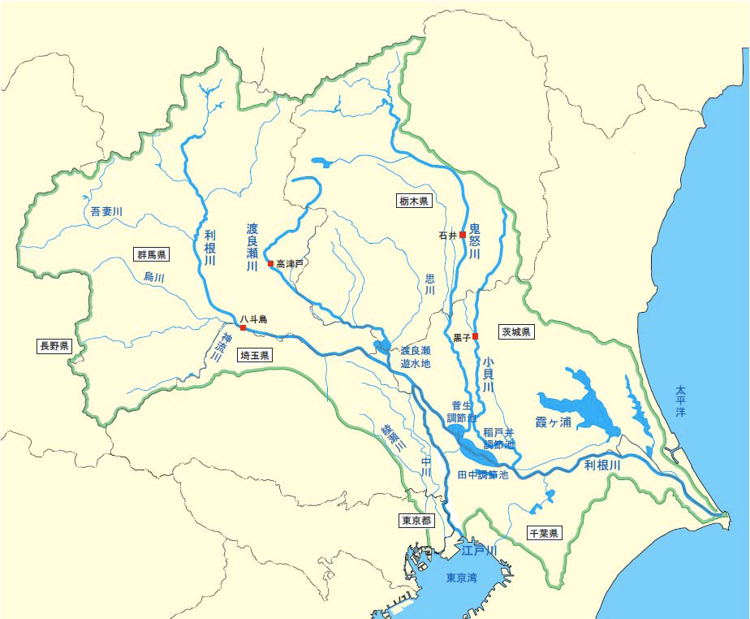
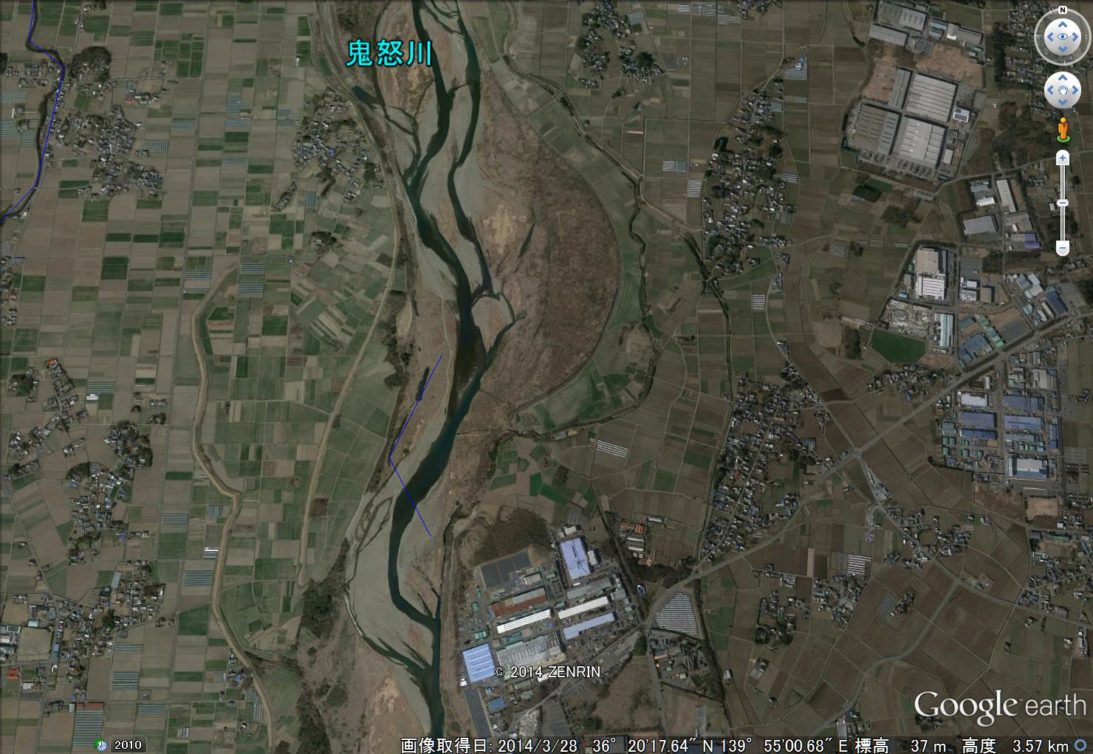
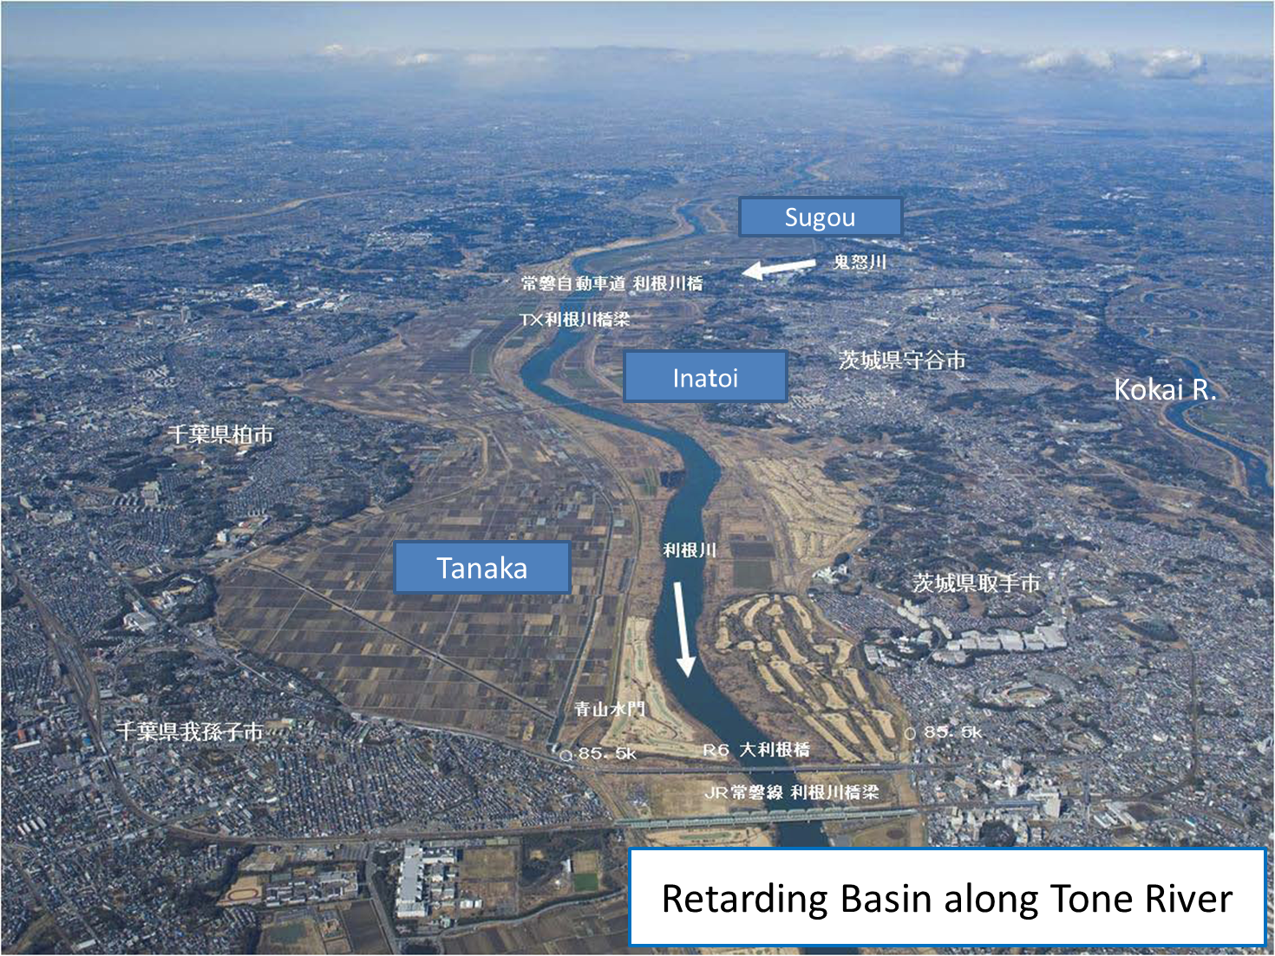
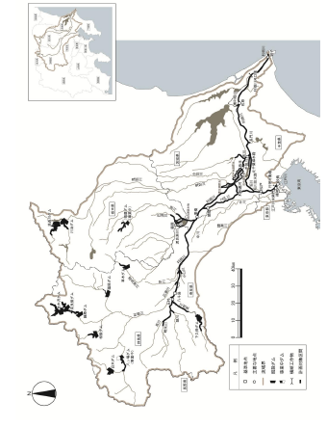

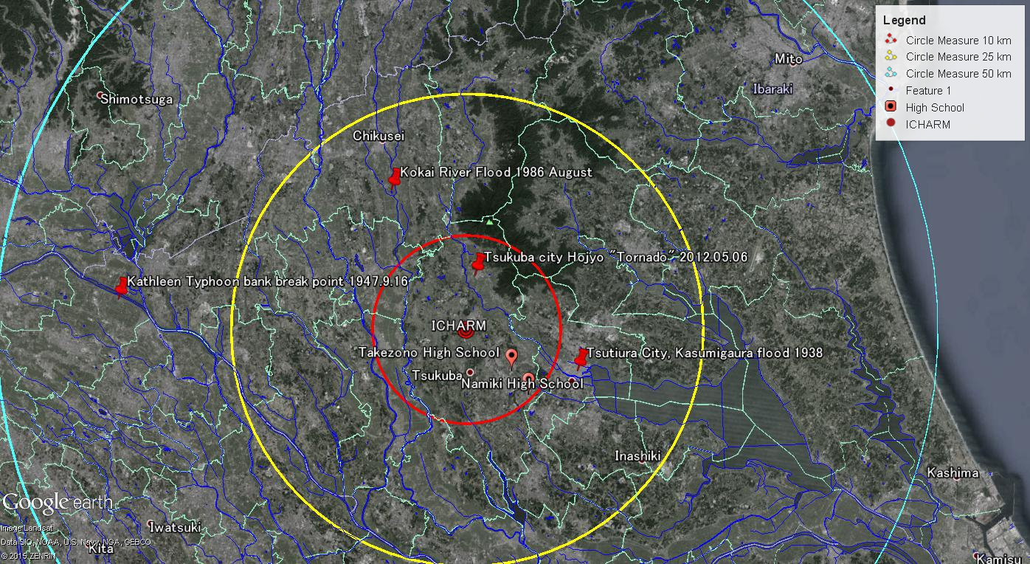
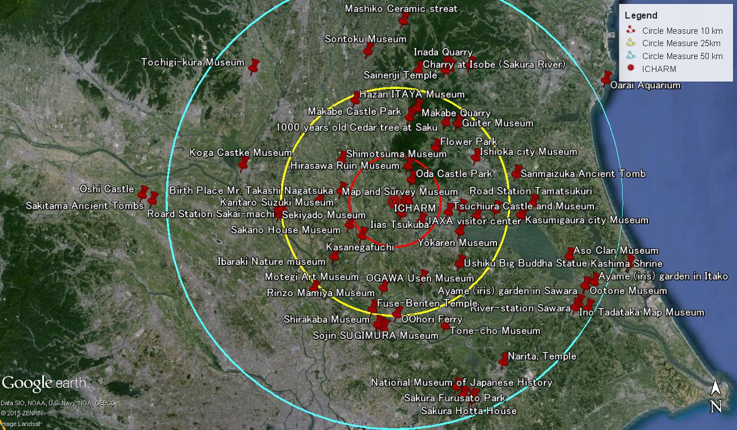
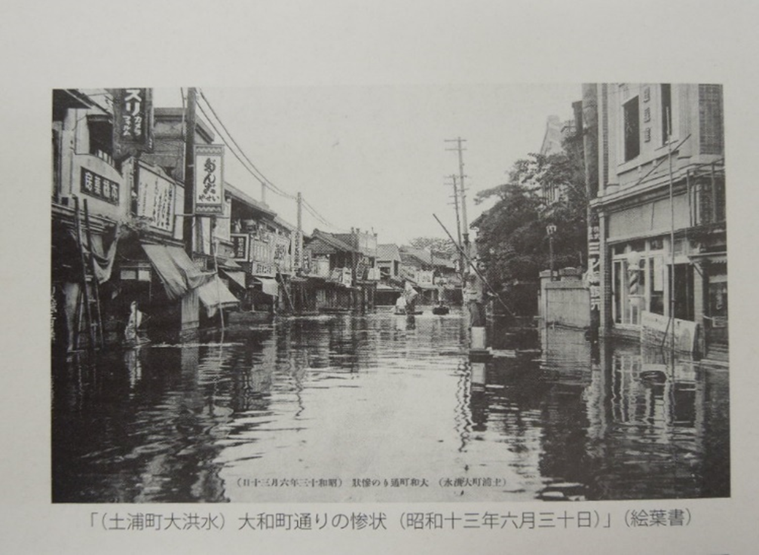
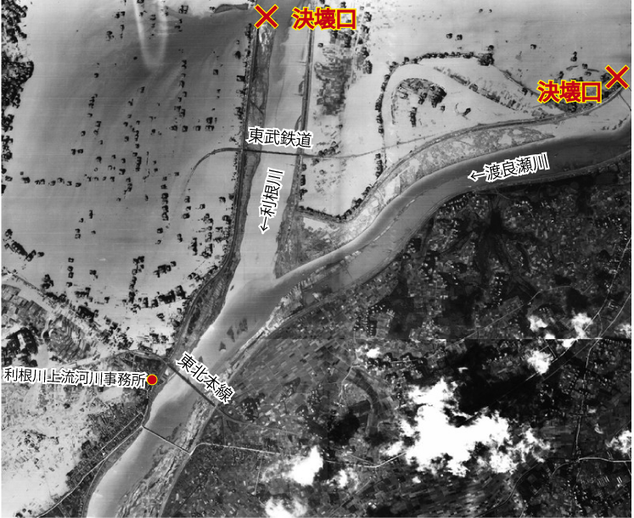
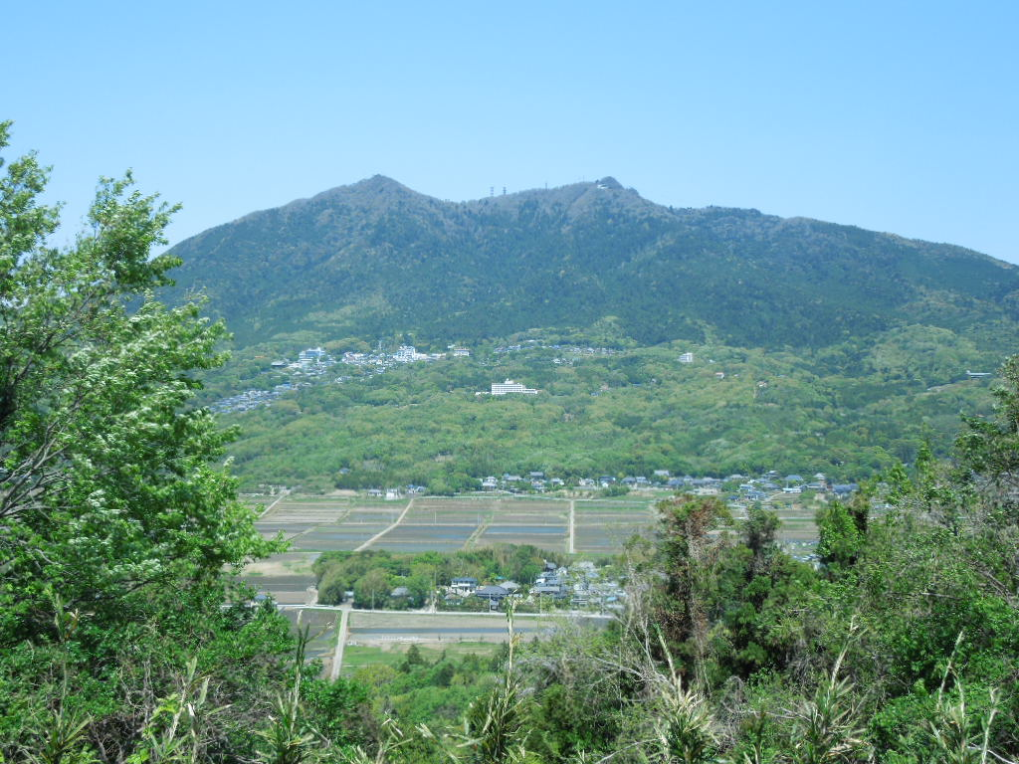
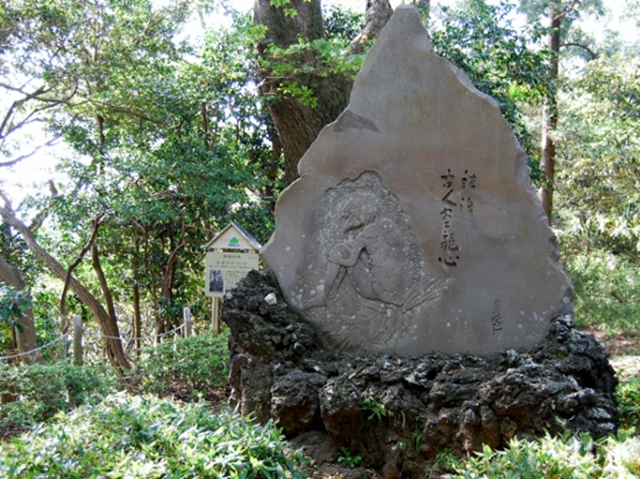
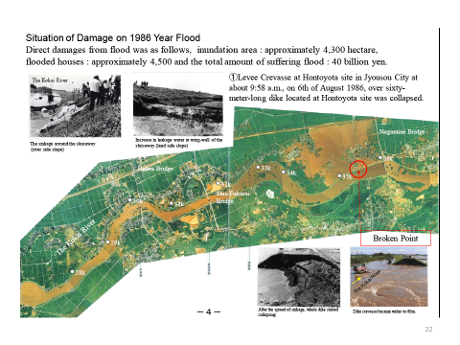
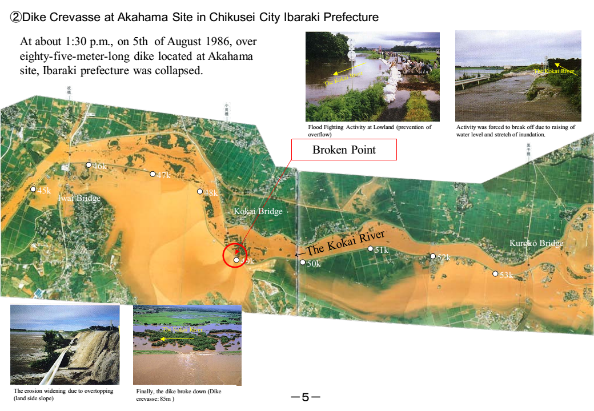
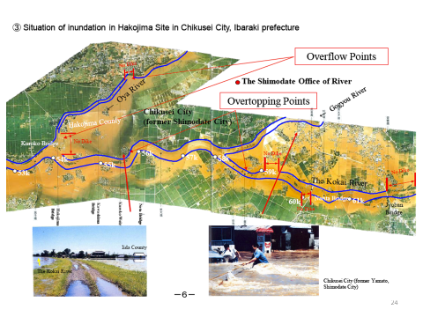
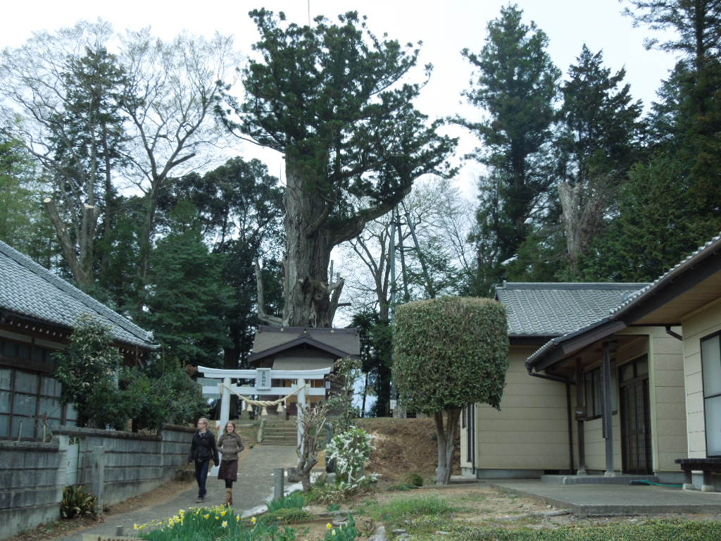
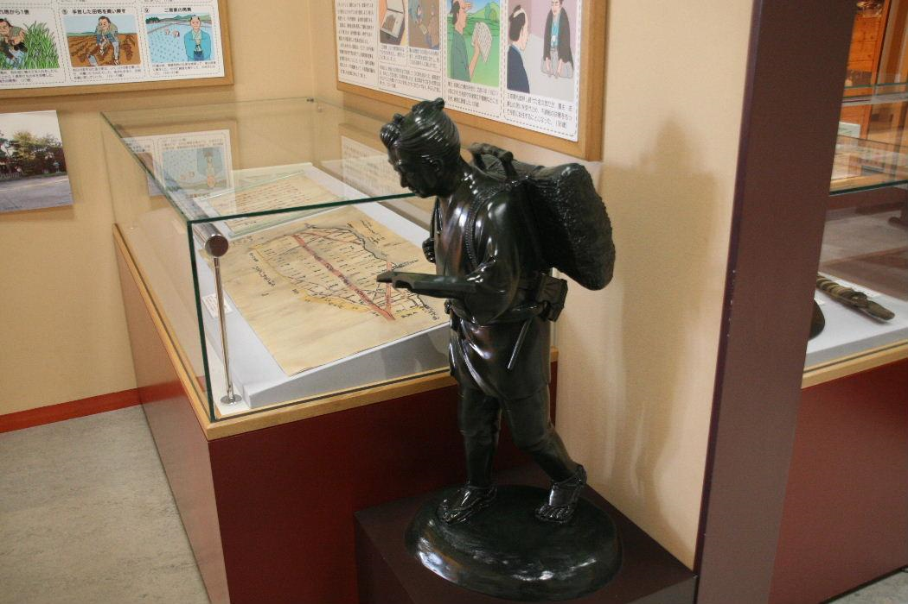
River and Water issues in the Vicinity of Tsukuba City Minoru KAMOTO¹
1: International Centre for Water Hazard and Risk Management (ICHARM) under the auspices of UNESCO, Public Works Research Institute (PWRI),
1-6 Minamihara, Tsukuba, Ibaraki, 305-8516 JAPAN : kamoto@pwri.go.jp
1. Rivers and Marshes
Tone River
Main Stream : 322 km
Catchment area: 16,840 km²
5 prefectures and Tokyo-Metropolis
Population in the Basin: 12,790 million
Tone Canal
Direct Management Stretch by MLIT (Ministry of Land, Infrastructure, Transport and Tourism)
3. Disasters & Border of Municipalities
4. Museums and Cultural Heritages
Kathleen Typhoon Bank break of Tone River at Kurihashi
1947.9.16
Flood at Tsuchiura from Kasumi-ga-ura Lake in 1938 (Showa 13)
Mt. Tsukuba
My love has got deep enough to make a pool now, as well as the drops from the peak of Mt. Tsukuba make a deep pool in Minano River.
Kappa by Usen Ogawa at Ushiku
Flood at Kokai River in 1986
Sontoku Museum at Ninomiya, Mooka
1000 years Cedar
tree at Saku, Yasato

